Slide 1

An Analysis By James Hunter
Notes:
Test

Slide 2
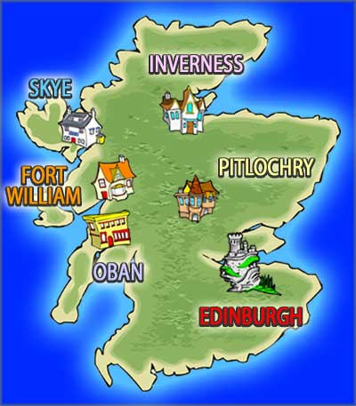
The Analysis
A deeper understanding to enhance tourism experience
Where are people spending their money?
What are they doing while they visit?
Who are they?
Where are they visiting?
How are they getting here?
Where are they staying?
How have things changed?

Slide 3

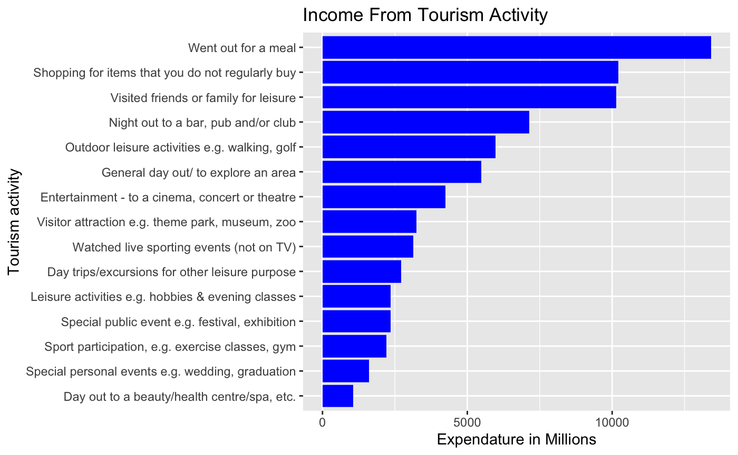
Where are they spending their money?
Restaurant Hospitality - 1,915 Million
High Street - 1,460 Million
Friends and Family Leisure - 1,448 Million

Slide 4

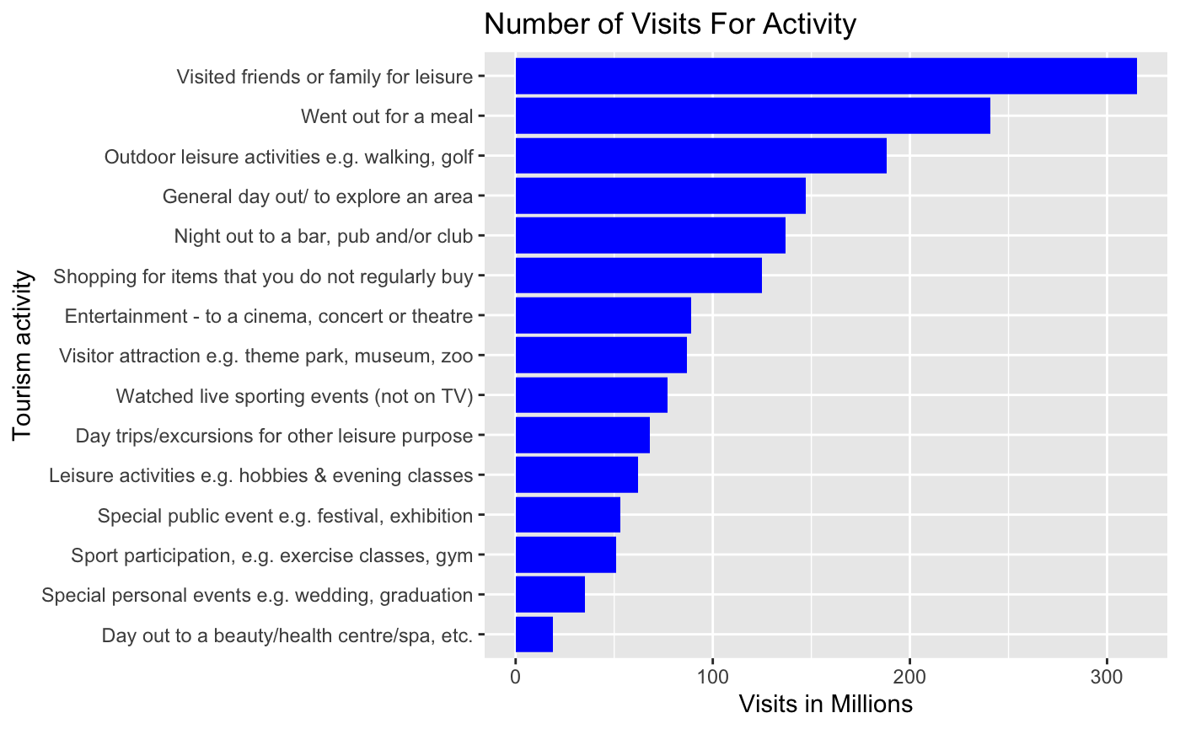
What are they doing while they visit?
Friends and Family Leisure - 45 Million
Restaurant Hospitality - 34 Million
Outdoor Leisure - 27 Million

Slide 5
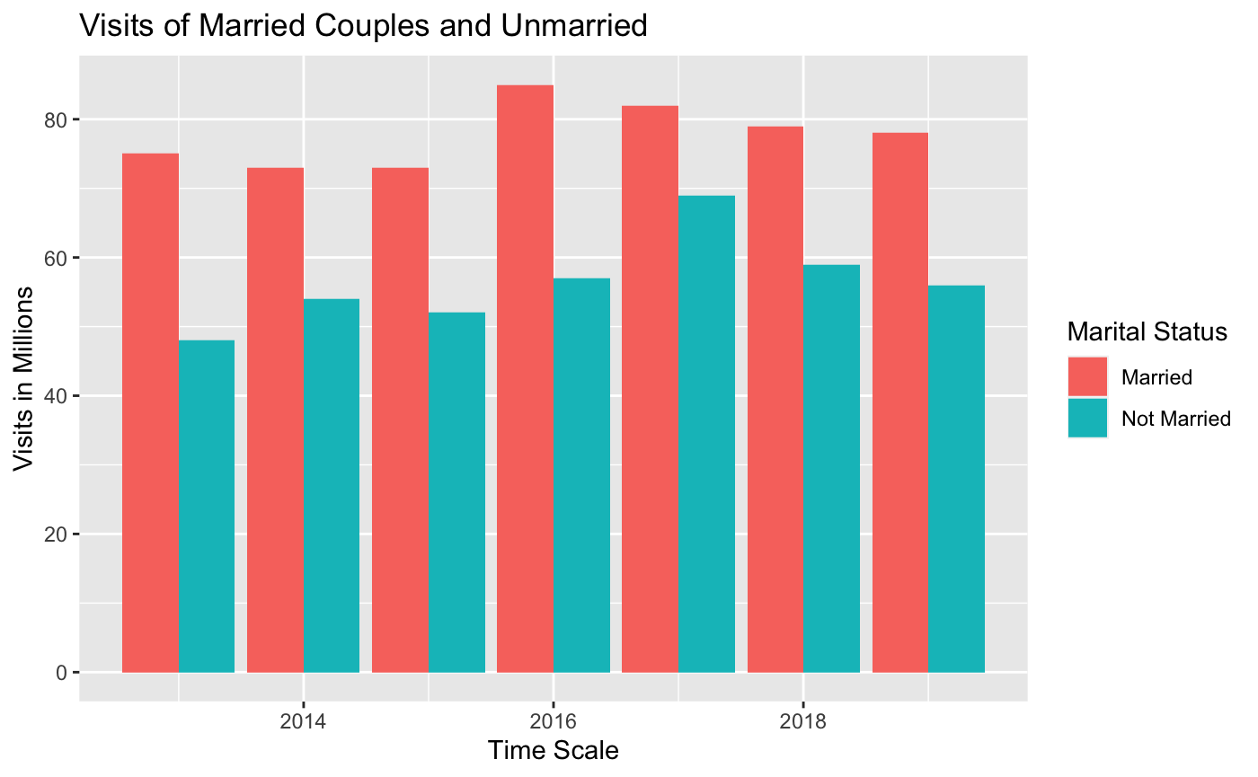
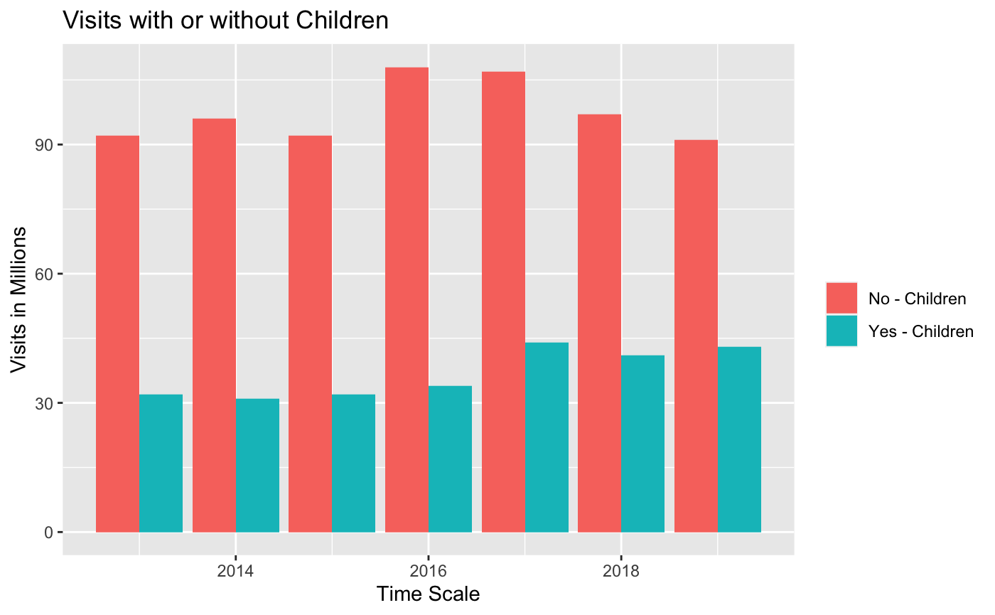
Who are they?
Predominantly Married couples without children

Slide 6
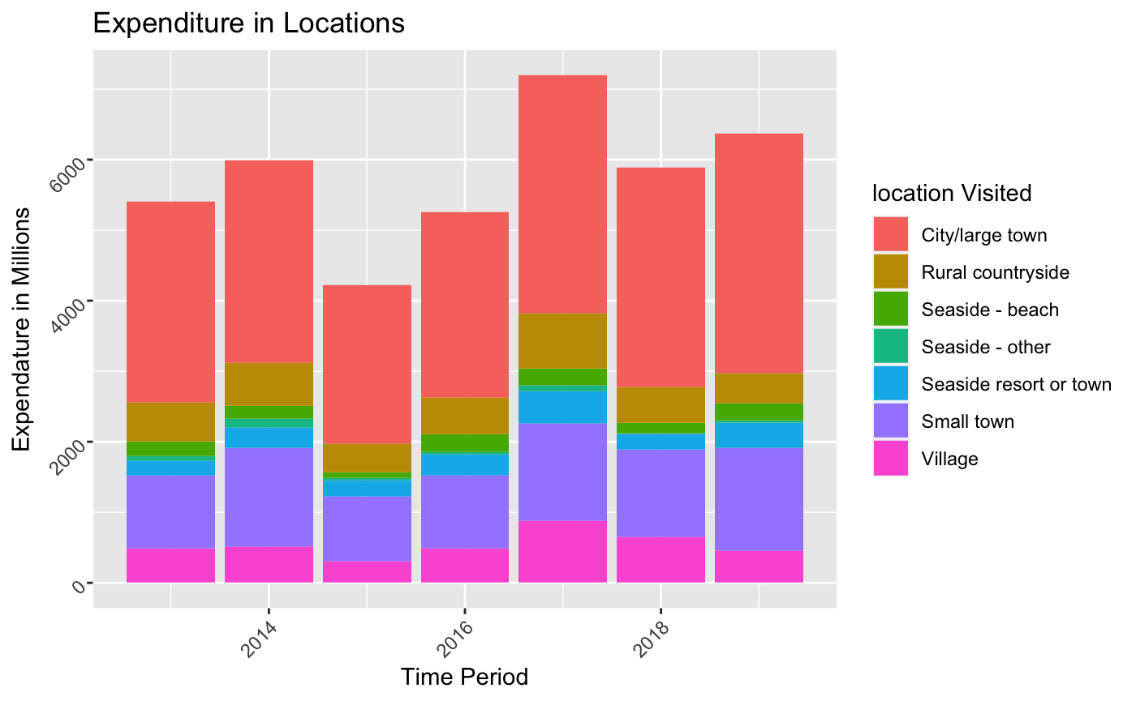

Where are they visiting?
Primarily Large towns and cities
Sizable amount visiting small towns with moderate amount of expenditure.

Slide 7

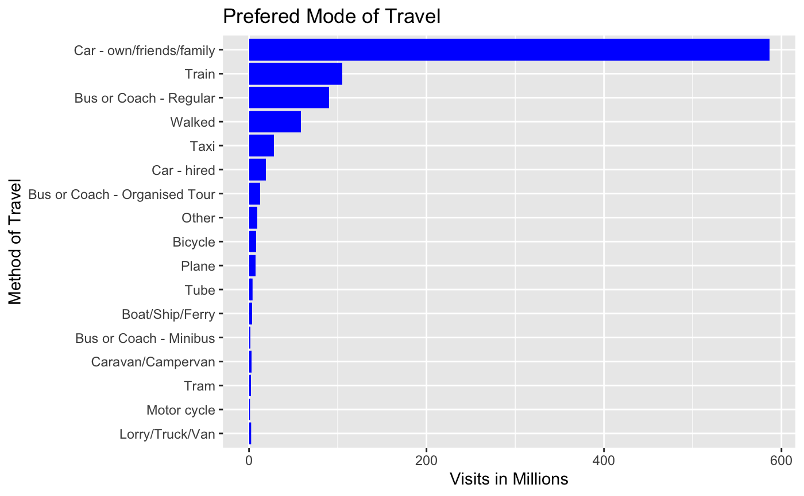
How are they getting here?
Private cars by a huge margin

Slide 8

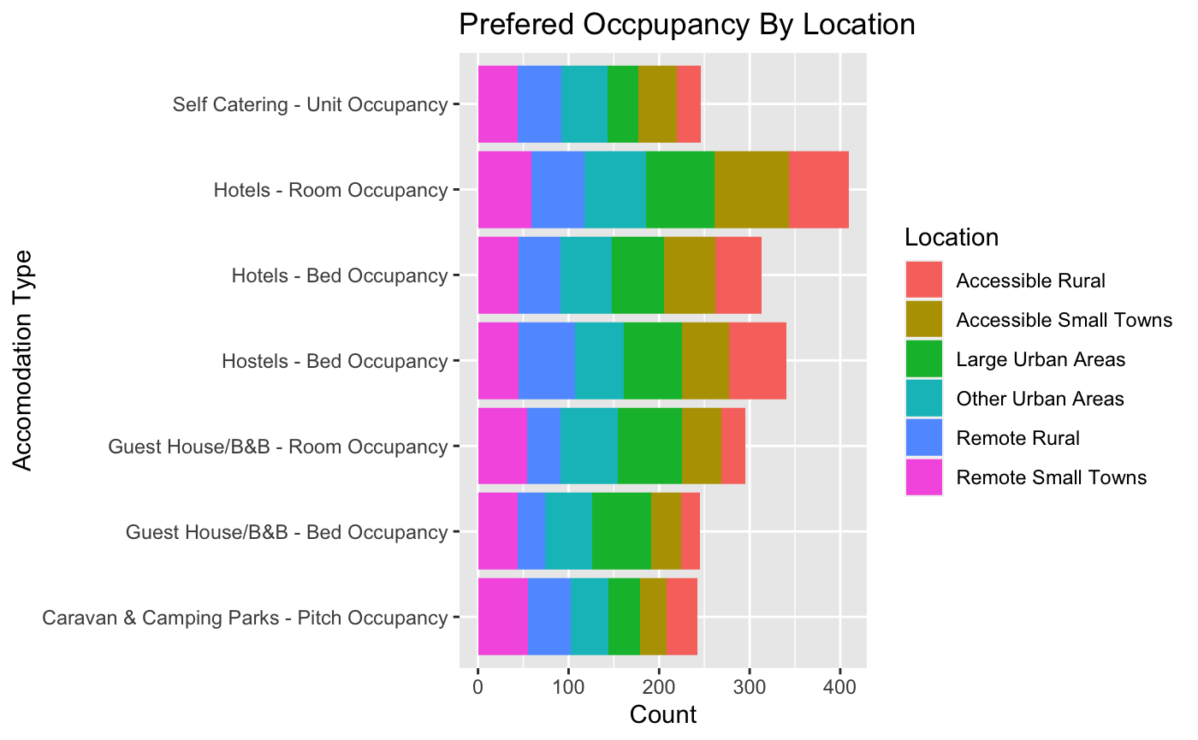
Where are they staying?
Hotels are the preferred place to stay in all areas apart from rural where Hostels are preferred.

Slide 9

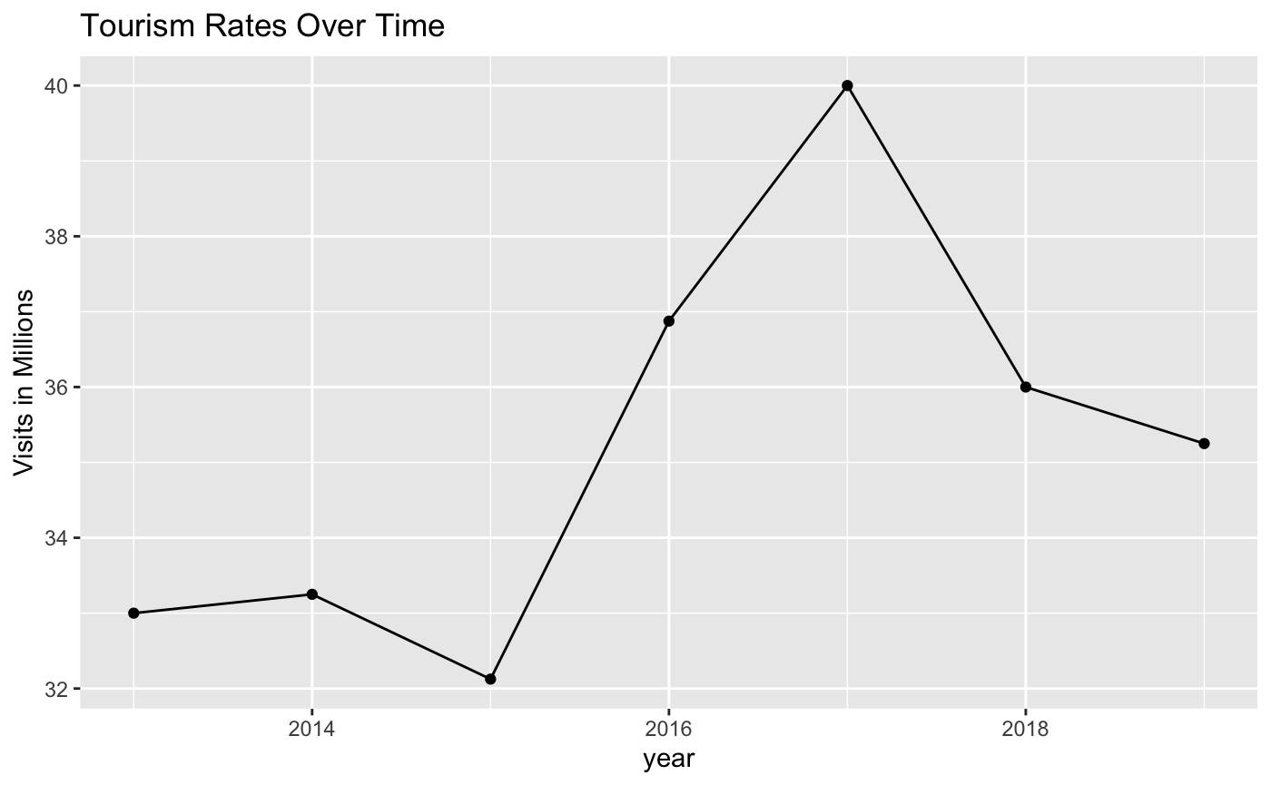
How have things changed?
What Triggered the steep climb in 2015.
What cause the fall in 2017

Slide 10

Questions?

